Slide 1
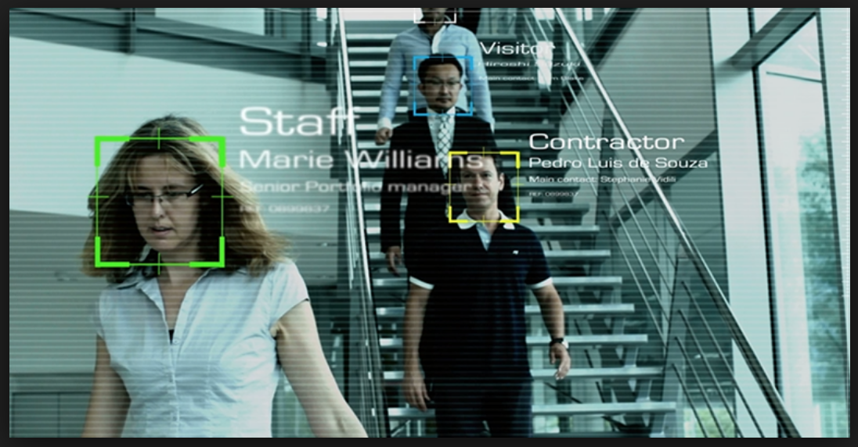
Facial Recognition
Projects presentation

Slide 2
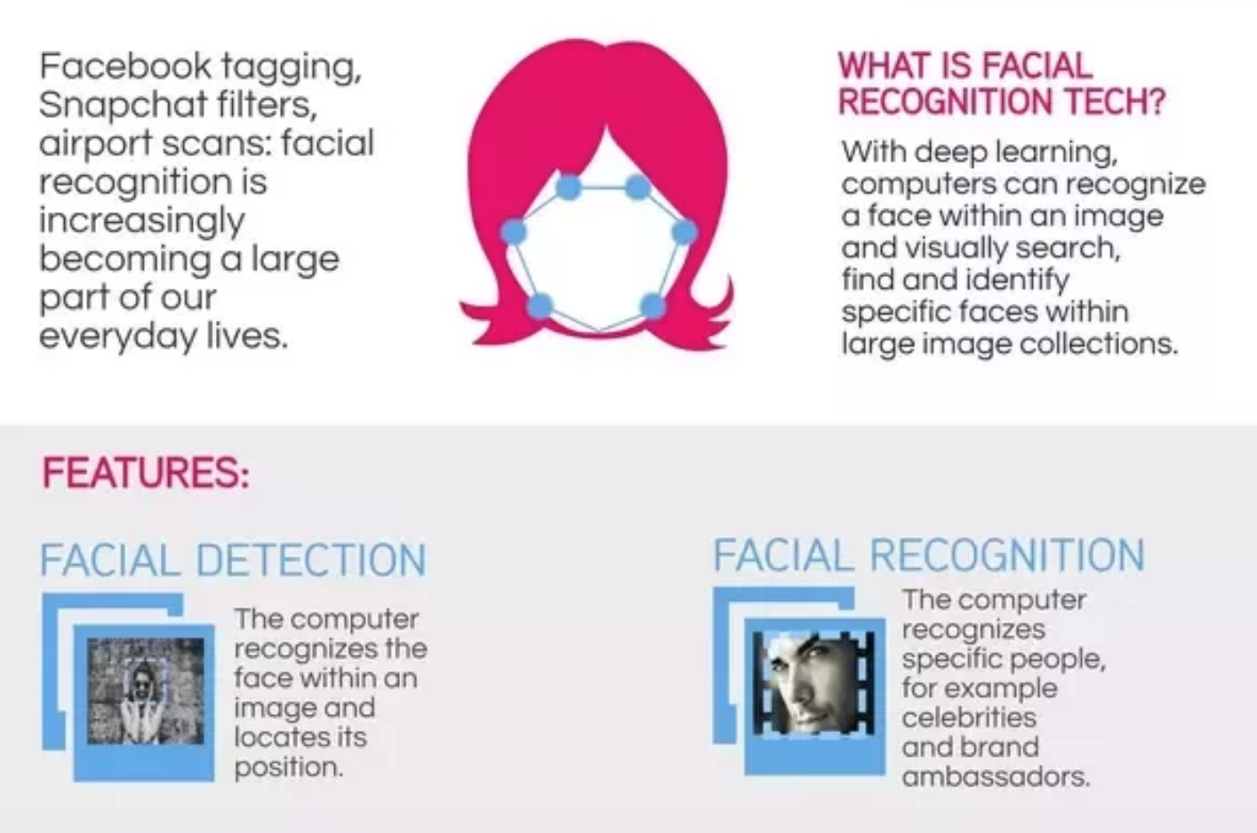
Face Detection vs Face Recognition
Though sounding similar, the complexity involved in both is vastly different.
In Face Detection, the computer recognizes the face within an image and locates its position.
Face recognition deals with identification to establish whose face it is by matching it to an existing face database.

Slide 3
Applications for Facial Recognition Technology

Slide 4

Payments
MasterCard announced the European roll out of Identity Check Mobile, a new payment technology application that uses biometrics like fingerprints or facial recognition to verify a cardholder’s identity, simplifying online shopping

Slide 5
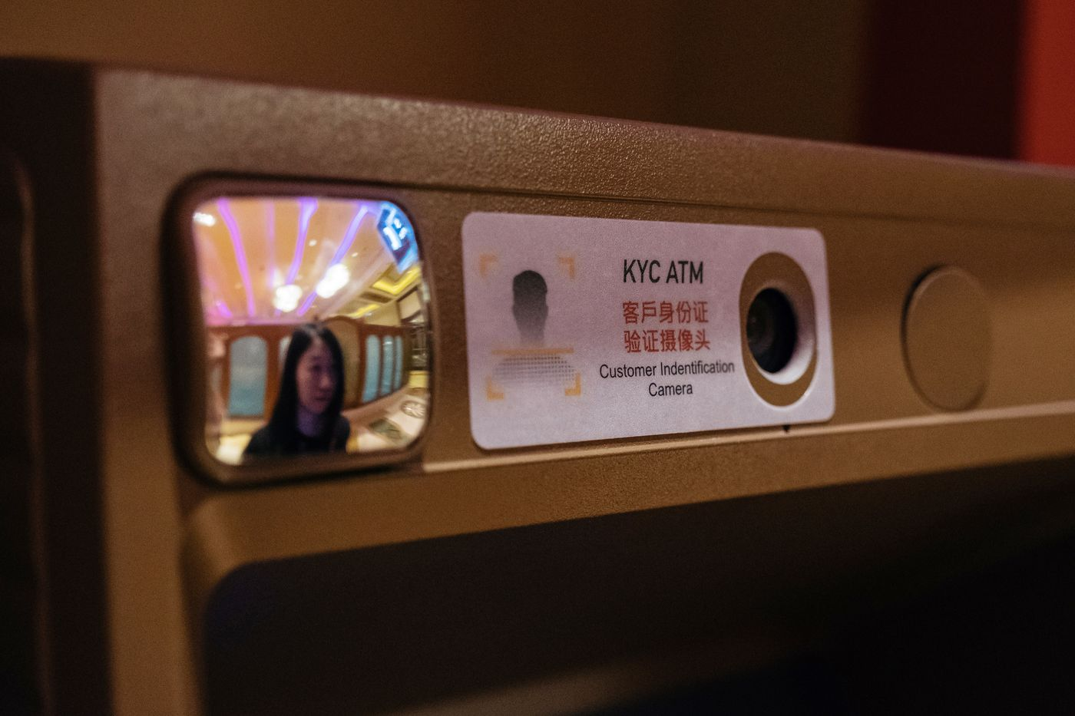
ATM Payments
An ATM equipped with facial-recognition system in Macau.

Slide 6
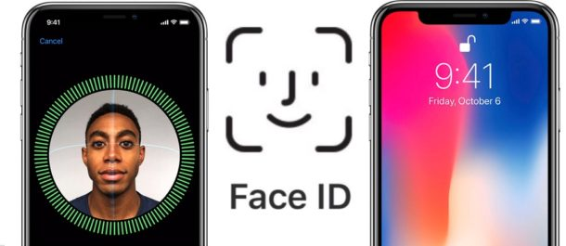
Access and security
Facial biometrics can be integrated with physical devices and objects.
Instead of using passcodes, mobile phones and other consumer electronics will be accessed via owners’ facial features.
Apple, Samsung and Xiaomi Corp. have all installed FaceTech in their phones.
In future, it looks like consumers will be able to get into their cars, houses, and other secure physical locations simply by looking at them.

Slide 7
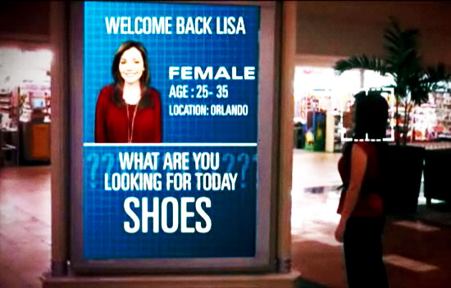
Advertising
FaceTech could do much the same, by allowing companies to recognize certain demographics – for instance, if the customer is a male between the ages of 12 and 21, the screen might show an ad for the latest FIFA game. In Florida stores use facial recognition technology and tracking to increase sales, they know who you’re and what you are looking to buy.

Slide 8
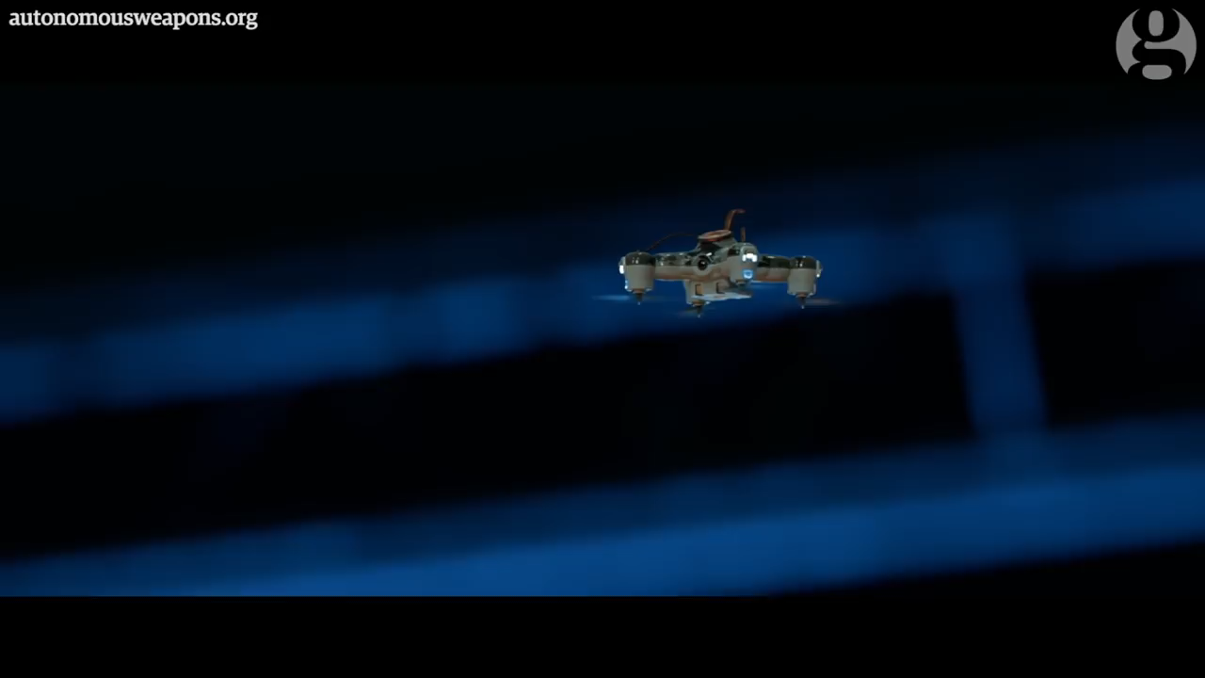
Arms industry
Technology now exists to create autonomous weapons that can select and kill human targets without supervision.

Slide 9
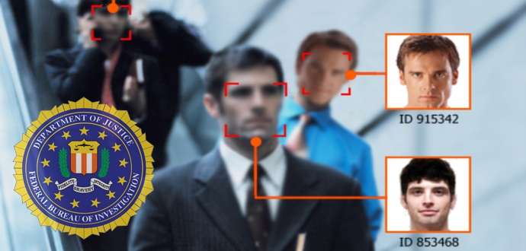
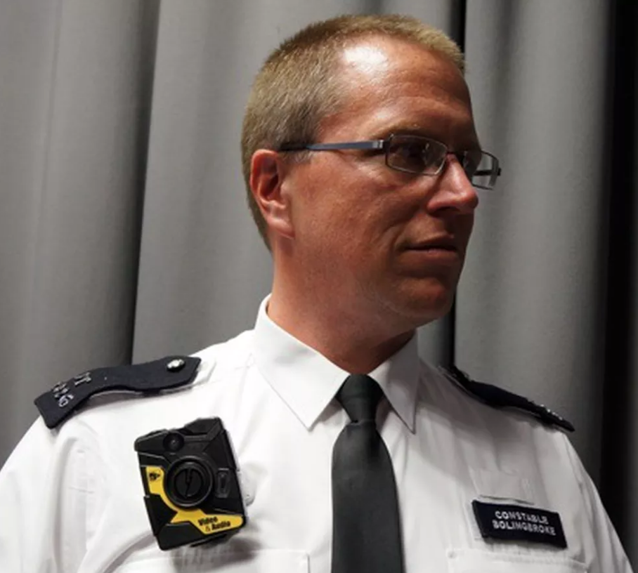
Video surveillance
FBI’s facial recognition system can access 411 million photos including foreigners.
This is as useful as it is creepy, giving law enforcers another way of tracking criminals across the country.
AI equipped cameras have also been trialled in the UK to identify those smuggling contraband into prisons.
Facial recognition allows security companies and law enforcement agencies to monitor suspicious or undesirable persons. Faces are compared against large databases, and authorities are alerted when there’s a match. London's Metropolitan Police is today deploying 500 wearable cameras as part of its officers' emergency response kit. Taser is the name of the company that will equip London's cops with on-body cameras

Slide 10
Face Recognition Projects

Slide 11
Face Recognition Projects
The project consists in creating a neural network for the recognition of faces within the dataset. The steps to follow will be:
- data acquisition, the frames containing the face must be extracted from the videos;
- data cleaning, clean up the acquired data;
- data normalization, perform the cropping of the face within the frame and eventually center the face according to the eyes;
- creation of a neural network for face recognition, as from knowledge acquired within this course;
- performance analysis, provide the tables and graphs needed to explain the performance of the neural network created.
The novelty of this dataset compared to the state of the art is that the video are acquired on subjects in movements from cameras in motion.

Slide 12
BIPLAB Dataset
The dataset on which to perform the experiments is the dataset created in the BIPLAB, content:
- 434 total videos;
- 62 subjects;
- 7 types of videos for each subject:
indoor with artificial lighting (cooperative and non-cooperative mode),
indoor with flash (cooperative and non-cooperative mode),
outdoor with natural lighting (cooperative and non-cooperative mode),
3D face video.
The novelty of this dataset compared to the state of the art is that the video are acquired on subjects in movements from cameras in motion.

Slide 13



BIPLAB Dataset
Indoor with flash
3D face
Outdoor
This project require groups of 3-4 persons.
Students who work on this project will have to sign a release for the non-dissemination of data.

